Slide 1
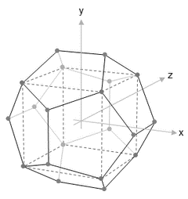
NISRA
Data Science Bootcamp
WELCOME
Course Title – Week 7 Python for Data Science
Course Tutor: Ashish Kumar
30th Jan – 3rd Feb 2017

Slide 2
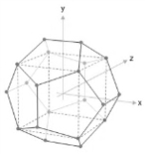

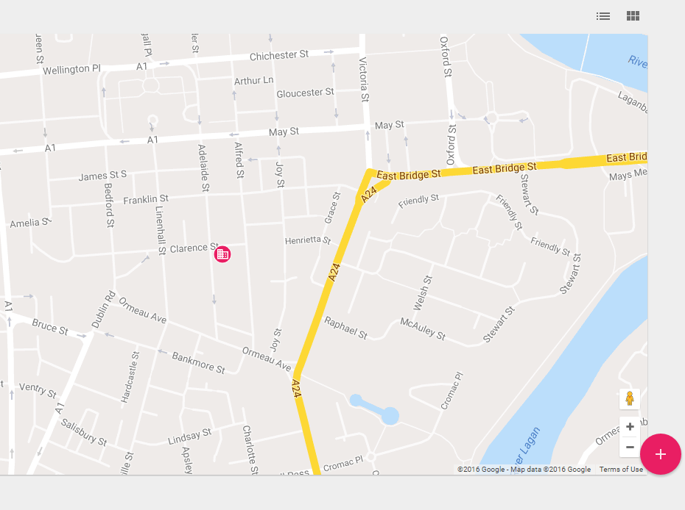
Course Locations
Location 1: ‘The Stables’, Stormont Castle
Location 2: ‘iD Lab’, Adelaide Street, Belfast

Slide 3
Your Attention Please
Fire Alarm
There are no fire alarm tests scheduled for today. So, if you do hear the fire alarm siren, or announcements asking you to leave the building, please leave immediately by the nearest available exit.
Staff in high visibility jackets will direct you to the assembly point.
Please take a moment to locate the exits around you now.
Toilets
The NISRA Stables Training Room toilets are located
The Intelligent Datalytics toilets are located on your left as you enter the office.
Refreshments
The NISRA kitchen for coffee and tea is available
Vending machines are available for refreshments on the 1st Floor of the Premier Business Centre.

Slide 4
Content Summary
Day 5 | Predictive Analytics with Python | Details | Start | End | Format
 | Introduction to other useful packages | Introduction to SciPy and NumPy Basic Statistics Introduction to scikit-learn | 09:00 | 10.30 | Practical
 | Linear Regression with Python | Sample Project 1 | 10.45 | 12.15 | Practical
 | Logistic Regression with Python | Sample Project 2 | 13.00 | 14.30 | Practical
 | Optional | Workshop | 14.45 | 16.15 | Practical
 | Wrap up / Q & A Discussion |  | 16.15 | 16.45 | Q&A

Slide 5
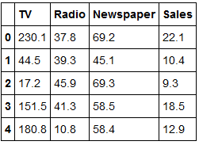
Day 5: Projects
Linear Regression using Scikit learn
Advertising dataset
Cost of advertising on Radio, TV & Newspaper
Total Sales

Slide 6
Day 5: Projects
Linear Regression using Scikit learn
Importing required packages
from sklearn.linear_model import LinearRegression
from sklearn.cross_validation import train_test_split
Defining predictor and outcome variable
feature_cols = ['TV', 'Radio']
X = advert[feature_cols]
Y = advert['Sales']

Slide 7
Day 5: Projects
Linear Regression using Scikit learn
Defining training & testing sets
trainX,testX,trainY,testY = train_test_split(X,Y, test_size = 0.2)
Creating and fitting the model
lm = LinearRegression()
lm.fit(trainX, trainY)

Slide 8

Day 5: Projects
Linear Regression using Scikit learn
Finding the results
print lm.intercept_
print lm.coef_
zip(feature_cols, lm.coef_)
lm.score(trainX, trainY) #finding the R2
lm.predict(testX) #predicting based on the model on test data

Slide 9
Day 5: Projects
Linear Regression using Scikit learn
Feature Selection
from sklearn.feature_selection import RFE
from sklearn.svm import SVR
feature_cols = ['TV', 'Radio','Newspaper']
X = advert[feature_cols]
Y = advert['Sales']
estimator = SVR(kernel="linear")
selector = RFE(estimator,2,step=1)
selector = selector.fit(X, Y)
selector.support_
selector.ranking_

Slide 10
Day 5: Projects
Linear Regression using Scikit learn
Recursive Feature Elimination
Backward Selection –
start with all the possible predictor variables in the model .
Discard a variable if:
a) the p-value of a predictor variable is large
b) the value of the adjusted R² goes up
c) the value of F-statistic goes down

Slide 11
Day 5: Projects
Linear Regression using Scikit learn
Alternative
import statsmodels.formula.api as smf
model1=smf.ols(formula='Sales~TV+Radio',data=advert).fit()
model1.params
model1.pvalues
model1.rsquared
model1.summary()
sales_pred=model1.predict(pd.DataFrame(advert['TV']))

Slide 12
Day 5: Projects
Text Classification
Features – word(s) for sentence classification, alphabet(s) for word classification
Supervised method
Naïve Bayes Classification

Slide 13
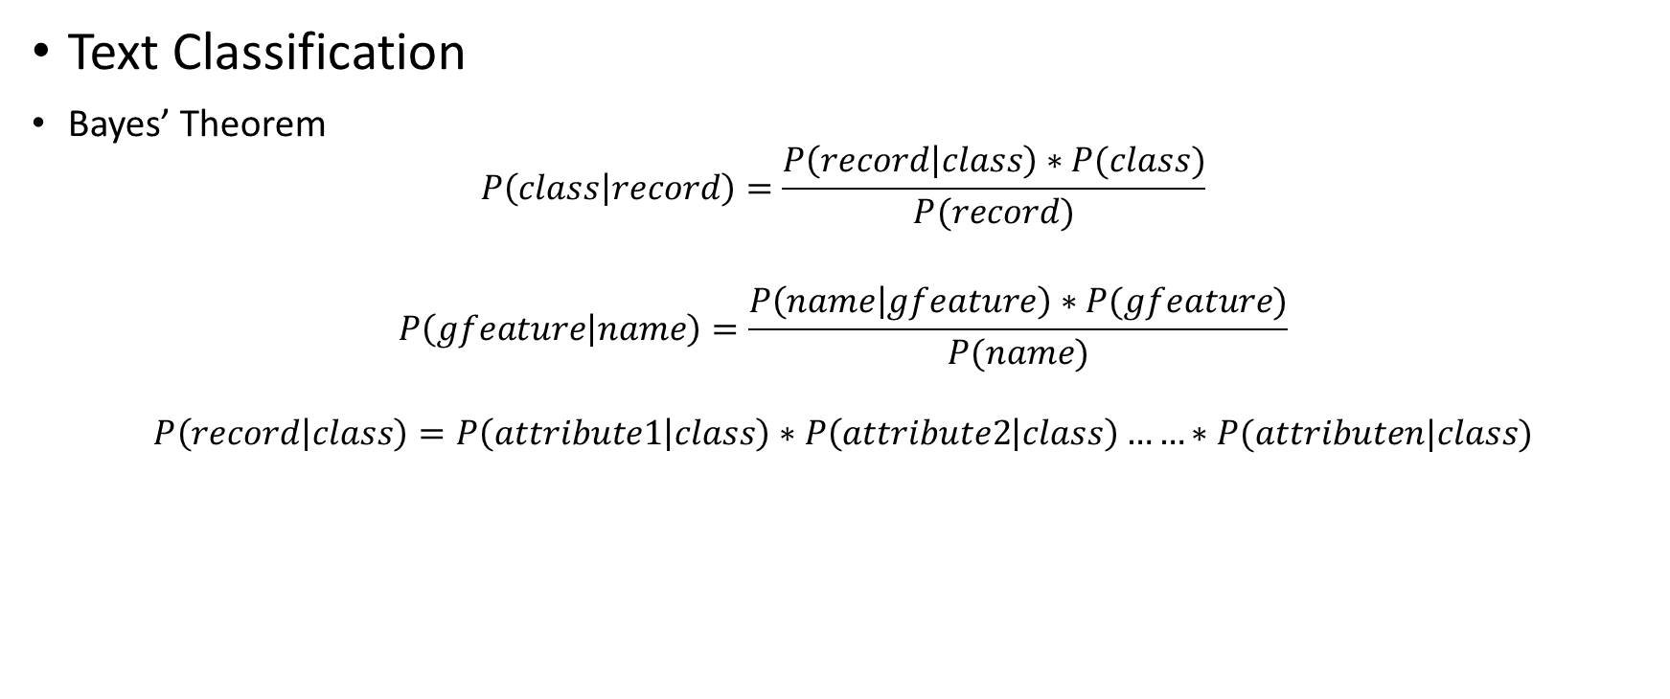
Day 5: Projects
Text Classification
Bayes’ Theorem
$$P\left(class | record\right)=\frac{P\left(record | class\right)∗P(class)}{P(record)}$$
$$P\left(gfeature | name\right)=\frac{P\left(name | gfeature\right)∗P(gfeature)}{P(name)}$$
$$P\left(record | class\right)=P\left(attribute1 | class\right)∗P\left(attribute2 | class\right)……∗P(attributen|class)$$

Slide 14
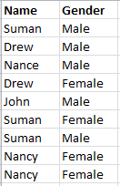
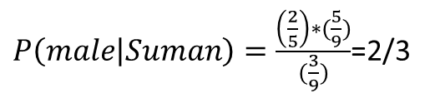
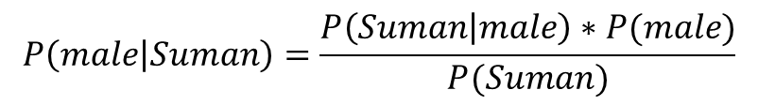





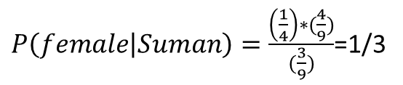
Day 5: Projects
$$P\left(male | Suman\right)=\frac{P\left(Suman | male\right)∗P(male)}{P(Suman)}$$
Text Classification
Bayes’ Theorem
$P\left(Suman | male\right)=$2/5
$P(Suman)=3$/9
$P(male)=$5/9
$P(female)=4$/9
$$P\left(Suman | female\right)=1/4$$
$P\left(male | Suman\right)=\frac{\left(\frac{2}{5}\right)∗(\frac{5}{9})}{(\frac{3}{9})}$=2/3
$P\left(female | Suman\right)=\frac{\left(\frac{1}{4}\right)∗(\frac{4}{9})}{(\frac{3}{9})}$=1/3

Slide 15
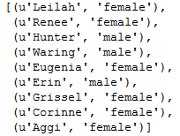
Day 5: Projects
Text Classification
Defining the dataset for text classification
from nltk.corpus import names
labeled_names = ([(name, 'male') for name in names.words('male.txt')] + [(name, 'female') for name in names.words('female.txt')])
import random
random.shuffle(labeled_names)

Slide 16
Day 5: Projects
Text Classification
Feature definition for text classification
Feature – e.g. alphabets of the word-first/last alphabet
def gender_features(word):
return {'last_letter': word[-1]}

Slide 17
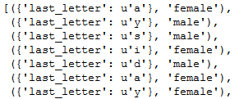
Day 5: Projects
Text Classification
Data Wrangling; Train/Test sampling
featuresets = [(gender_features(n), gender) for (n, gender) in labeled_names]
train_set, test_set = featuresets[500:], featuresets[:500]

Slide 18
Day 5: Projects
Text Classification
Model fitting and model accuracy
classifier = nltk.NaiveBayesClassifier.train(train_set)
nltk.classify.accuracy(classifier, test_set)

Slide 19
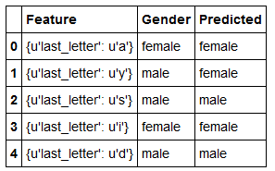
Day 5: Projects
Text Classification
Prediction
dftest=pd.DataFrame(test_set,columns=['Feature','Gender'])
dftest['Predicted']=dftest['Feature'].map(classifier.classify)

Slide 20
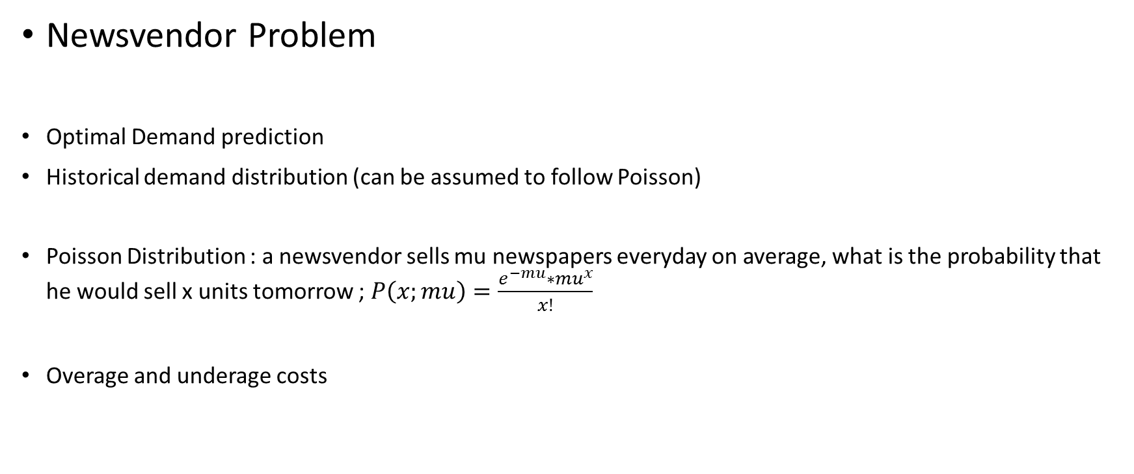
Day 5: Projects
Newsvendor Problem
Optimal Demand prediction
Historical demand distribution (can be assumed to follow Poisson)
Poisson Distribution : a newsvendor sells mu newspapers everyday on average, what is the probability that he would sell x units tomorrow ; $P\left(x;mu\right)=\frac{e^{−mu}∗{mu}^{x}}{x!}$
Overage and underage costs

Slide 21

Day 5: Projects
Newsvendor Problem
$$P\left(Demand>Q\right)∗sc=P\left(Demand≤Q\right)∗exc$$
$$sc∗(1−F\left(Q\right))=(F(Q)∗exc$$
$$F\left(Q\right)≥\frac{sc}{sc+exc}$$

Slide 22
Day 5: Projects
Newsvendor Problem
Generating dummy demand (assuming Poissing distribution)
def demand(size,lam):
import scipy as sp
pmf=[]
cdf=[]
for i in range(size):
d=sp.stats.distributions.poisson.pmf(i,lam)
c=sp.stats.distributions.poisson.cdf(i,lam)
pmf.append(d)
cdf.append(c)
return pmf,cdf

Slide 23
Day 5: Projects
Newsvendor Problem
Function to calculate critical ratio
def critical_ratio(sc,exc):
#sc=shortage cost
#exc=excess cost
r=sc/(sc+exc)
return r
d=demand(100,25)
rat=critical_ratio(1.75,.5)

Slide 24
Day 5: Projects
Newsvendor Problem
Finding optimal demand : Method 1
for i in range(len(d[1])):
if d[1][i]>=rat:
break
print "The critical ratio is %f!"%rat
print "The optimum demand is %d units!"%i

Slide 25
Day 5: Projects
Newsvendor Problem
Finding optimal demand : Method 2
import pandas as pd
import numpy as np
pmf=demand(100,25)[0]
cdf=demand(100,25)[1]
a=range(1,len(pmf)+1)
tab_dict={'PMF':pmf, 'CDF':cdf,'demand':a}
df=pd.DataFrame(tab_dict)
df['ratio']=rat
df['ind']=np.where(df['CDF']>=df['ratio'],1,0)
grouped=df.groupby(df['ind'])
grouped.first()

Slide 26
Day 5: Projects
Newsvendor Problem
Finding optimal demand : Method 3
%matplotlib inline
import matplotlib.pyplot as plt
plt.plot(df['demand'],df['CDF'])
plt.plot(df['ratio'])
plt.xlabel('Demand')
plt.ylabel('CDF')
plt.title('Newsvendor Problem')
print "The demand where the two plot intersect is the optimum demand."

